Slide 1










A WEST END
SPECTACULAR
24th JUNE 2020

Slide 2


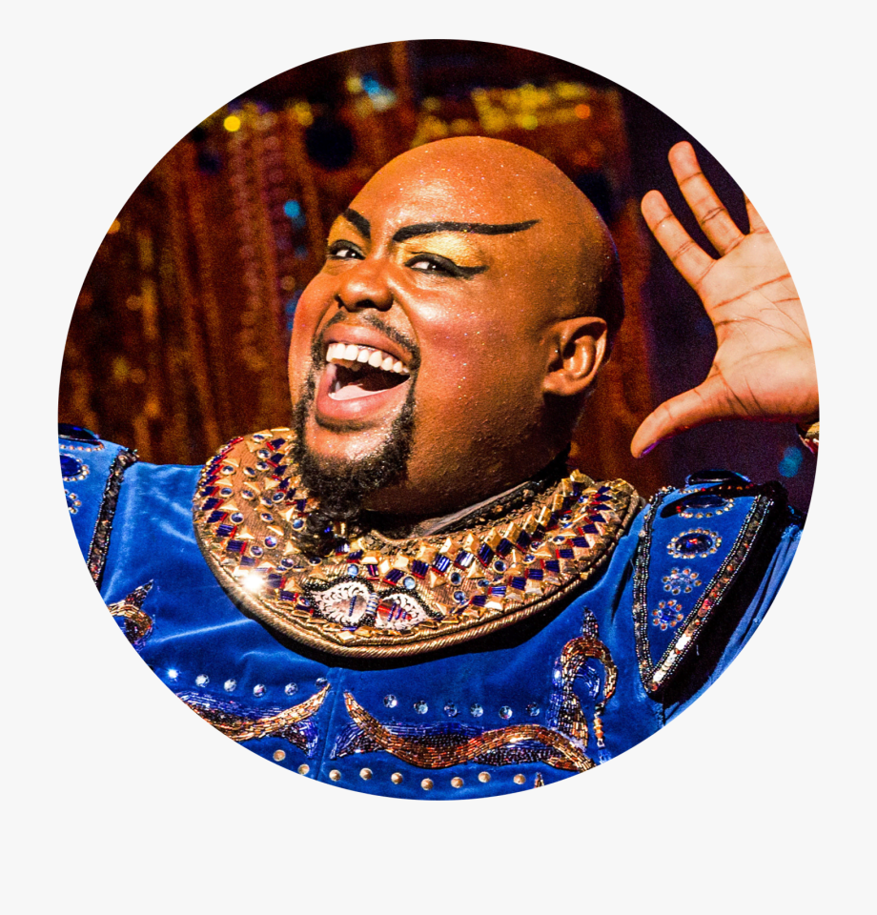
No.13 A Whole New World

Slide 3
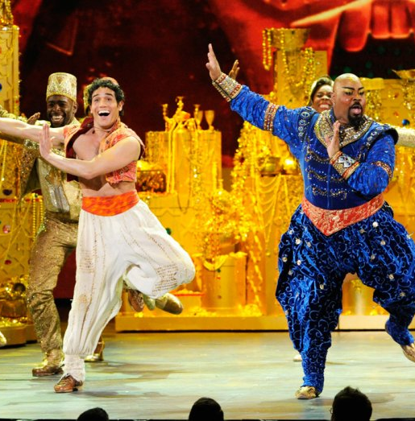
A whole new world
A new fantastic point of view
No one to tell us no, or where to go
Or say we're only dreaming
A whole new world
A dazzling place I never knew
But when I'm way up here, it's crystal clear
(Group 1)
That now I'm in a whole new world with you
(Group 2)
Now I'm in a whole new world with you

Slide 4
(Group 1)
Unbelievable sights
Indescribable feeling
(Group 2)
Soaring, tumbling, freewheeling
Through an endless diamond sky
(Group 1) A whole new world
(Group 2) Don't you dare close your eyes
(Group 1) A hundred thousand things to see
(Group 2) Hold your breath - it gets better
(Both)
I'm like a shooting star, I've come so far
I can't go back to where I used to be

Slide 5
(Group 1) A whole new world
(Group 2) Every turn a surprise
(Group 1) With new horizons to pursue
(Group 2) Every moment red-letter
(Both)
I'll chase them anywhere
There's time to spare
Let me share this whole new world with you.

Slide 6
(Group 1) A whole new world
(Group 2) A whole new world
(Group 1) That's where we'll be
(Group 2) That's where we'll be
(Group 1) A thrilling chase
(Group 2) A wondrous place
(Both) For you and me

Slide 7


