Slide 1










A WEST END
SPECTACULAR
24th JUNE 2020

Slide 2

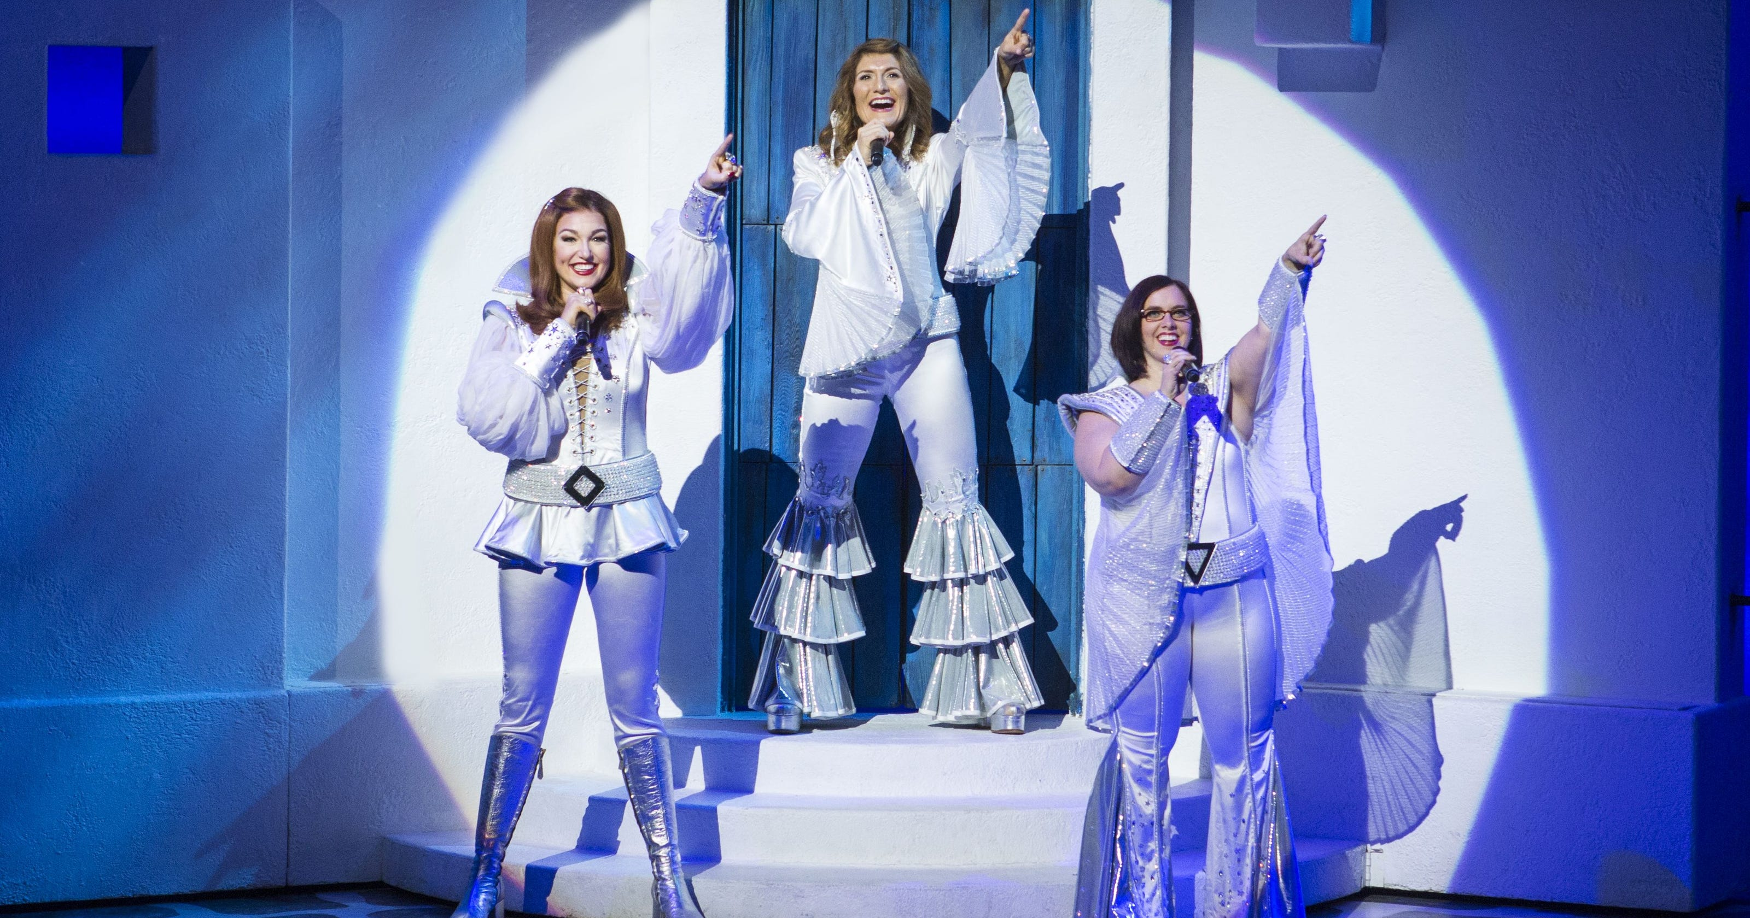

No.13 MAMA MIA!

Slide 3
I've been cheated by you since I don't know when
So I made up my mind, it must come to an end
Look at me now, will I ever learn?
I don't know how but I suddenly lose control
There's a fire within my soul
Just one look and I can hear a bell ring
One more look and I forget everything, w-o-o-o-oh

Slide 4
Mamma mia, here I go again
My my, how can I resist you?
Mamma mia, does it show again?
My my, just how much I've missed you
Yes, I've been broken-hearted
Blue since the day we parted
Why, why did I ever let you go?
Mamma mia, now I really know,
My my, I could never let you go.

Slide 5
I've been angry and sad ‘bout the things that you do
I can't count all the times that I've told you we're through
And when you go, when you slam the door
I think you know that you won't be away too long
You know that I'm not that strong.
Just one look and I can hear a bell ring
One more look and I forget everything,
w-o-o-o-oh

Slide 6
Mamma mia, here I go again
My my, how can I resist you?
Mamma mia, does it show again?
My my, just how much I've missed you
Yes, I've been broken-hearted
Blue since the day we parted
Why, why did I ever let you go?
Mamma mia, even if I say,
Bye-bye leave me now or never.
Mamma mia, it’s a game we play,
Bye-bye doesn’t mean forever.

Slide 7
Mamma mia, here I go again
My my, how can I resist you?
Mamma mia, does it show again?
My my, just how much I've missed you
Yes, I've been broken-hearted
Blue since the day we parted
Why, why did I ever let you go
Mamma mia, now I really know
My my, I could never let you go
MAMA MIA!

