Slide 1

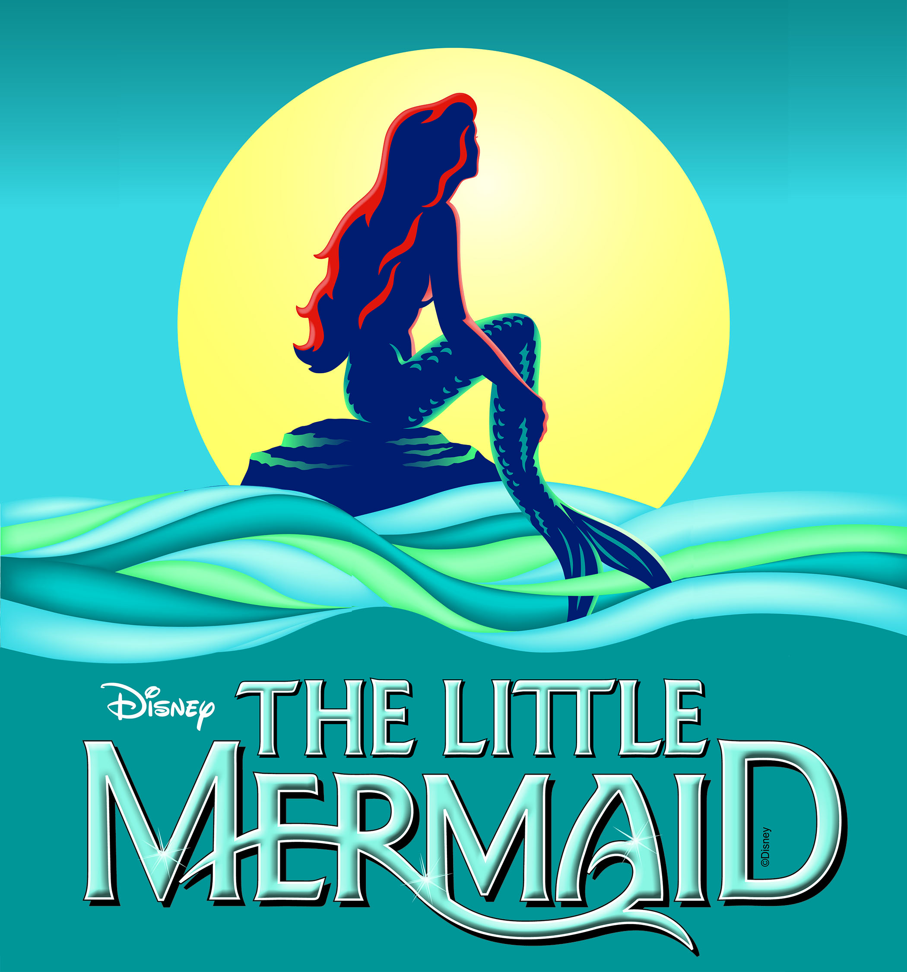





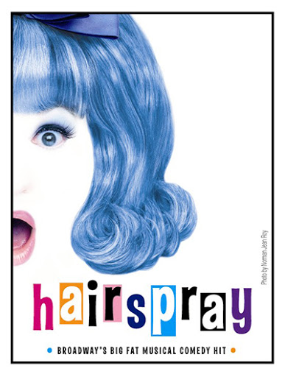
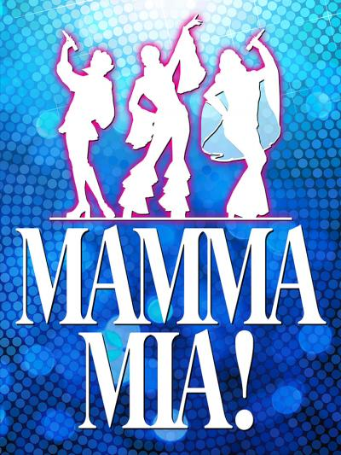
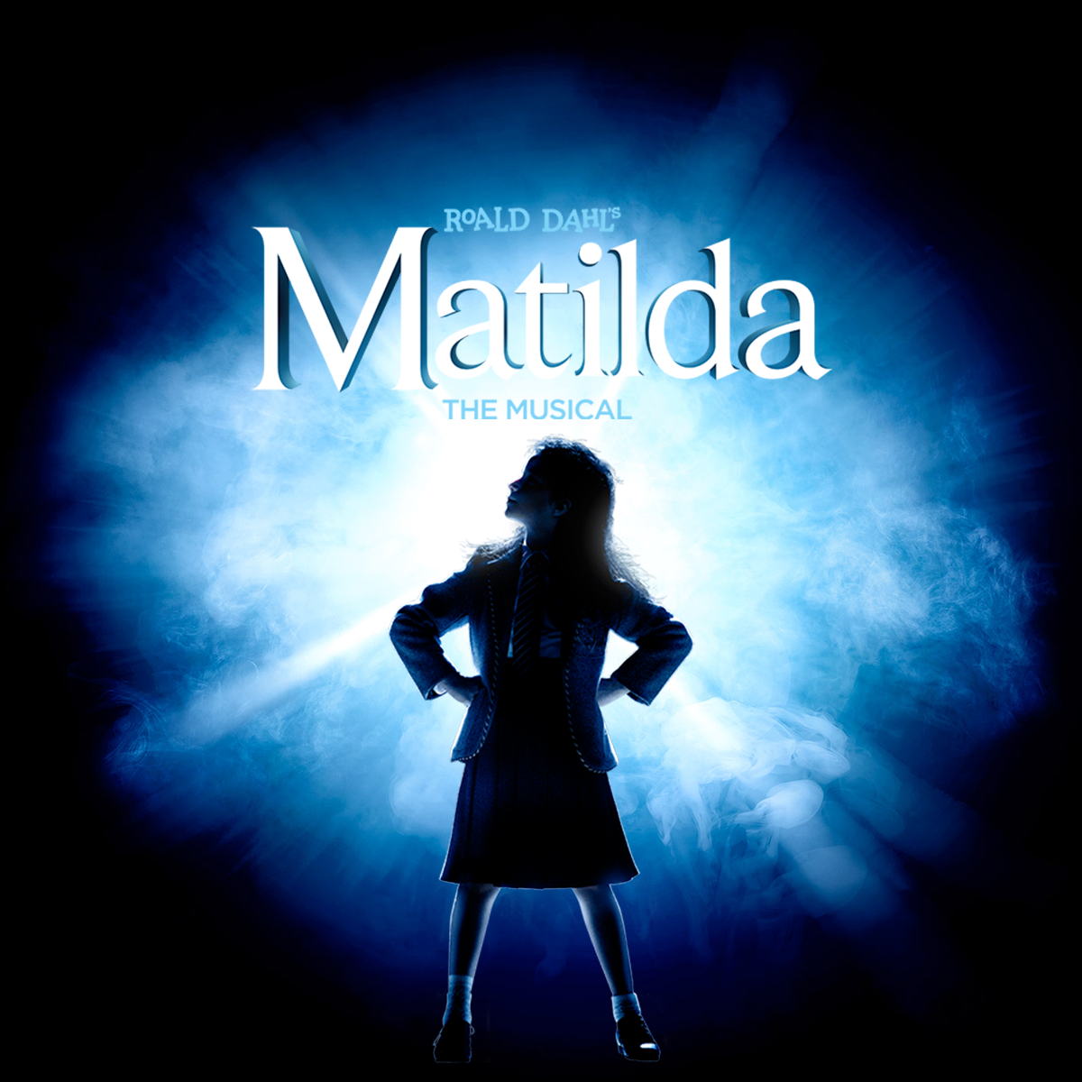
A WEST END
SPECTACULAR
24th JUNE 2020

Slide 2

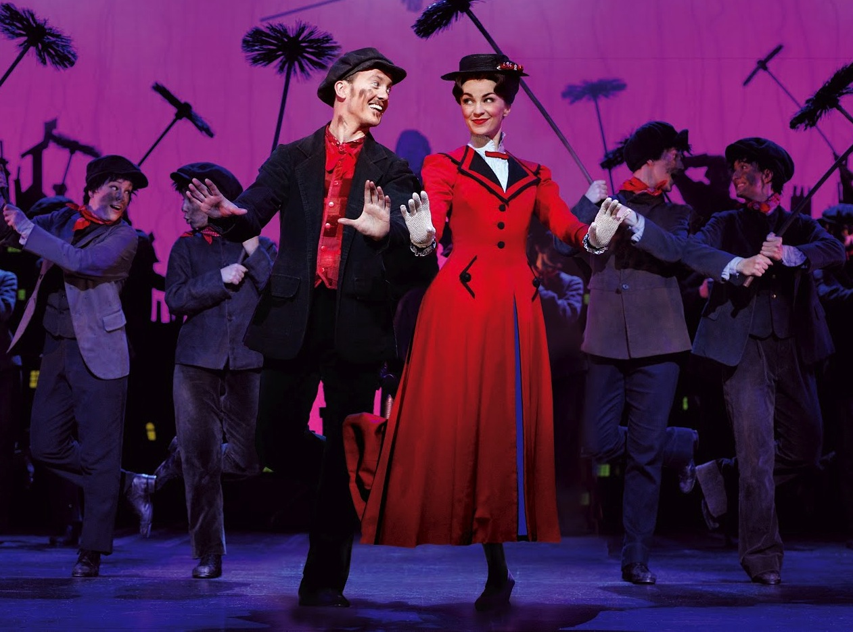

7. Mary Poppins Medley

Slide 3

Winds in the east, there’s a mist comin' in
Like somethin' is brewin' and 'bout to begin.
Can't put me finger on what lies in store,
But I feel what's to happen all happened before.
Chim chimeny chim chim, cheree chim cheroo!

Slide 4
With tuppence for paper and strings
You can have your own set of wings
With your feet on the ground
You're a bird in a flight
With your fist holding tight
To the string of your kite

Slide 5
Oh, oh, oh!
Let's go fly a kite
Up to the highest height!
Let's go fly a kite and send it soaring
Up to the atmosphere
Up where the air is clear
Oh, let's go fly a kite!

Slide 6
Early each day to the steps of Saint Paul's
The little old bird woman comes
In her own special way to the people she calls,
"Come, buy my bags full of crumbs.
Come feed the little birds,
Show them you care
And you'll be glad if you do

Slide 7
Their young ones are hungry
Their nests are so bare
All it takes is tuppence from you
Feed the birds, tuppence a bag
Tuppence, tuppence, tuppence a bag
"Feed the birds, tuppence a bag
Tuppence, tuppence, tuppence a bag"

Slide 8
Chim chim-in-ey, chim chim-in-ey
Chim chim cher-ee!
A sweep is as lucky, as lucky can be
Chim chim-in-ey, chim chim-in-ey
Chim chim cher-oo!
Good luck will rub off when I shakes 'ands with you
Or blow me a kiss and that's lucky too

Slide 9
Um-diddle-ittl-um-diddle-aye
Um-diddle-ittl-um-diddle-aye
Supercalifragilisticexpialidocious!
Even though the sound of it
Is something quite atrocious
If you say it loud enough
You'll always sound precocious
Supercalifragilisticexpialidocious

Slide 10
Supercalifragilisticexpialidocious!
Even though the sound of it
Is something quite atrocious
If you say it loud enough
You'll always sound precocious
Supercalifragilistic
Supercalifragilistic
Su-per-cal-i-frag-i-lis-tic
Ex—pi—a—li—do—cious.
Supercalifragilisticexpialidocious

